Slide 1
Hypoxia-reporter construct: tumor progression
Gilkes-Macklin Collaboration
AMIGOS
October 4th 2017

Slide 2
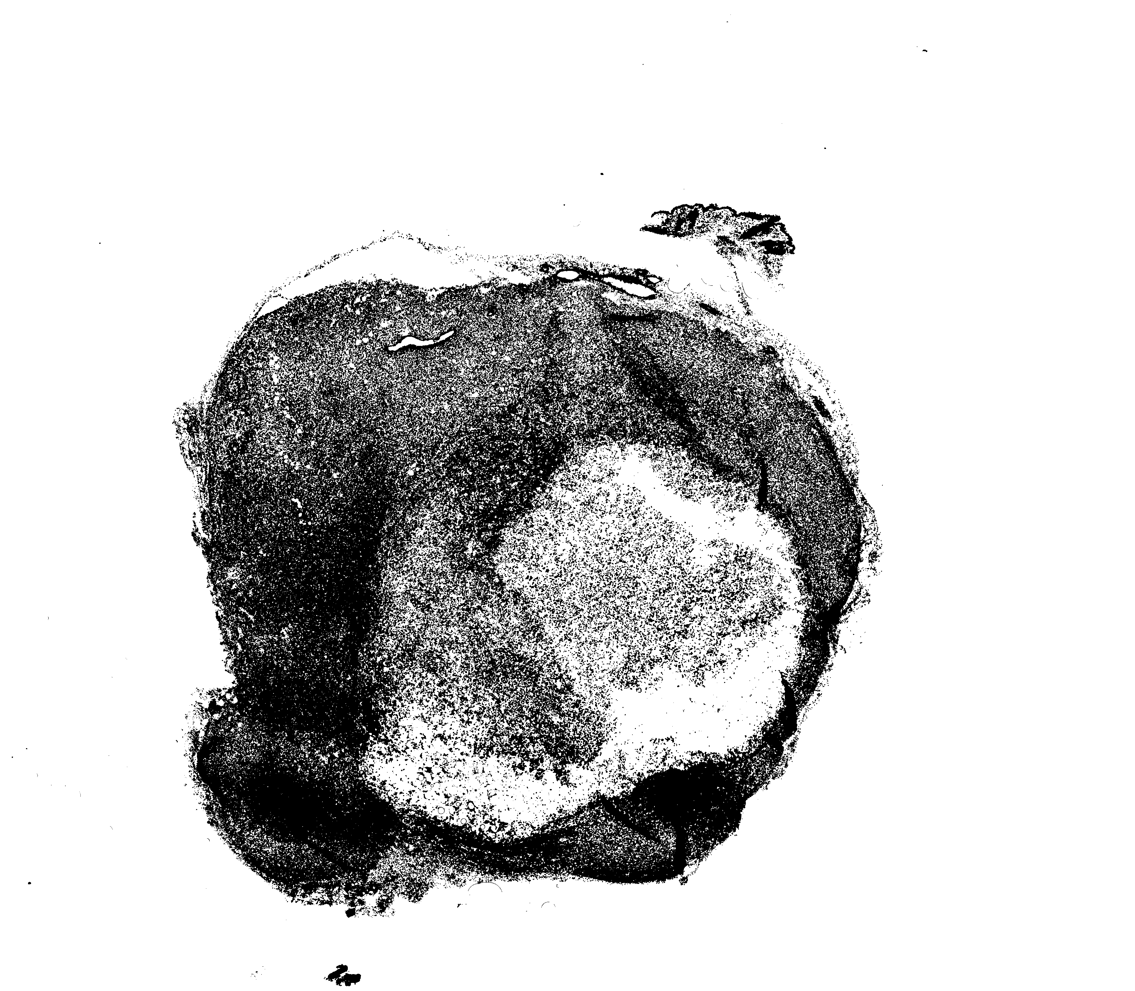
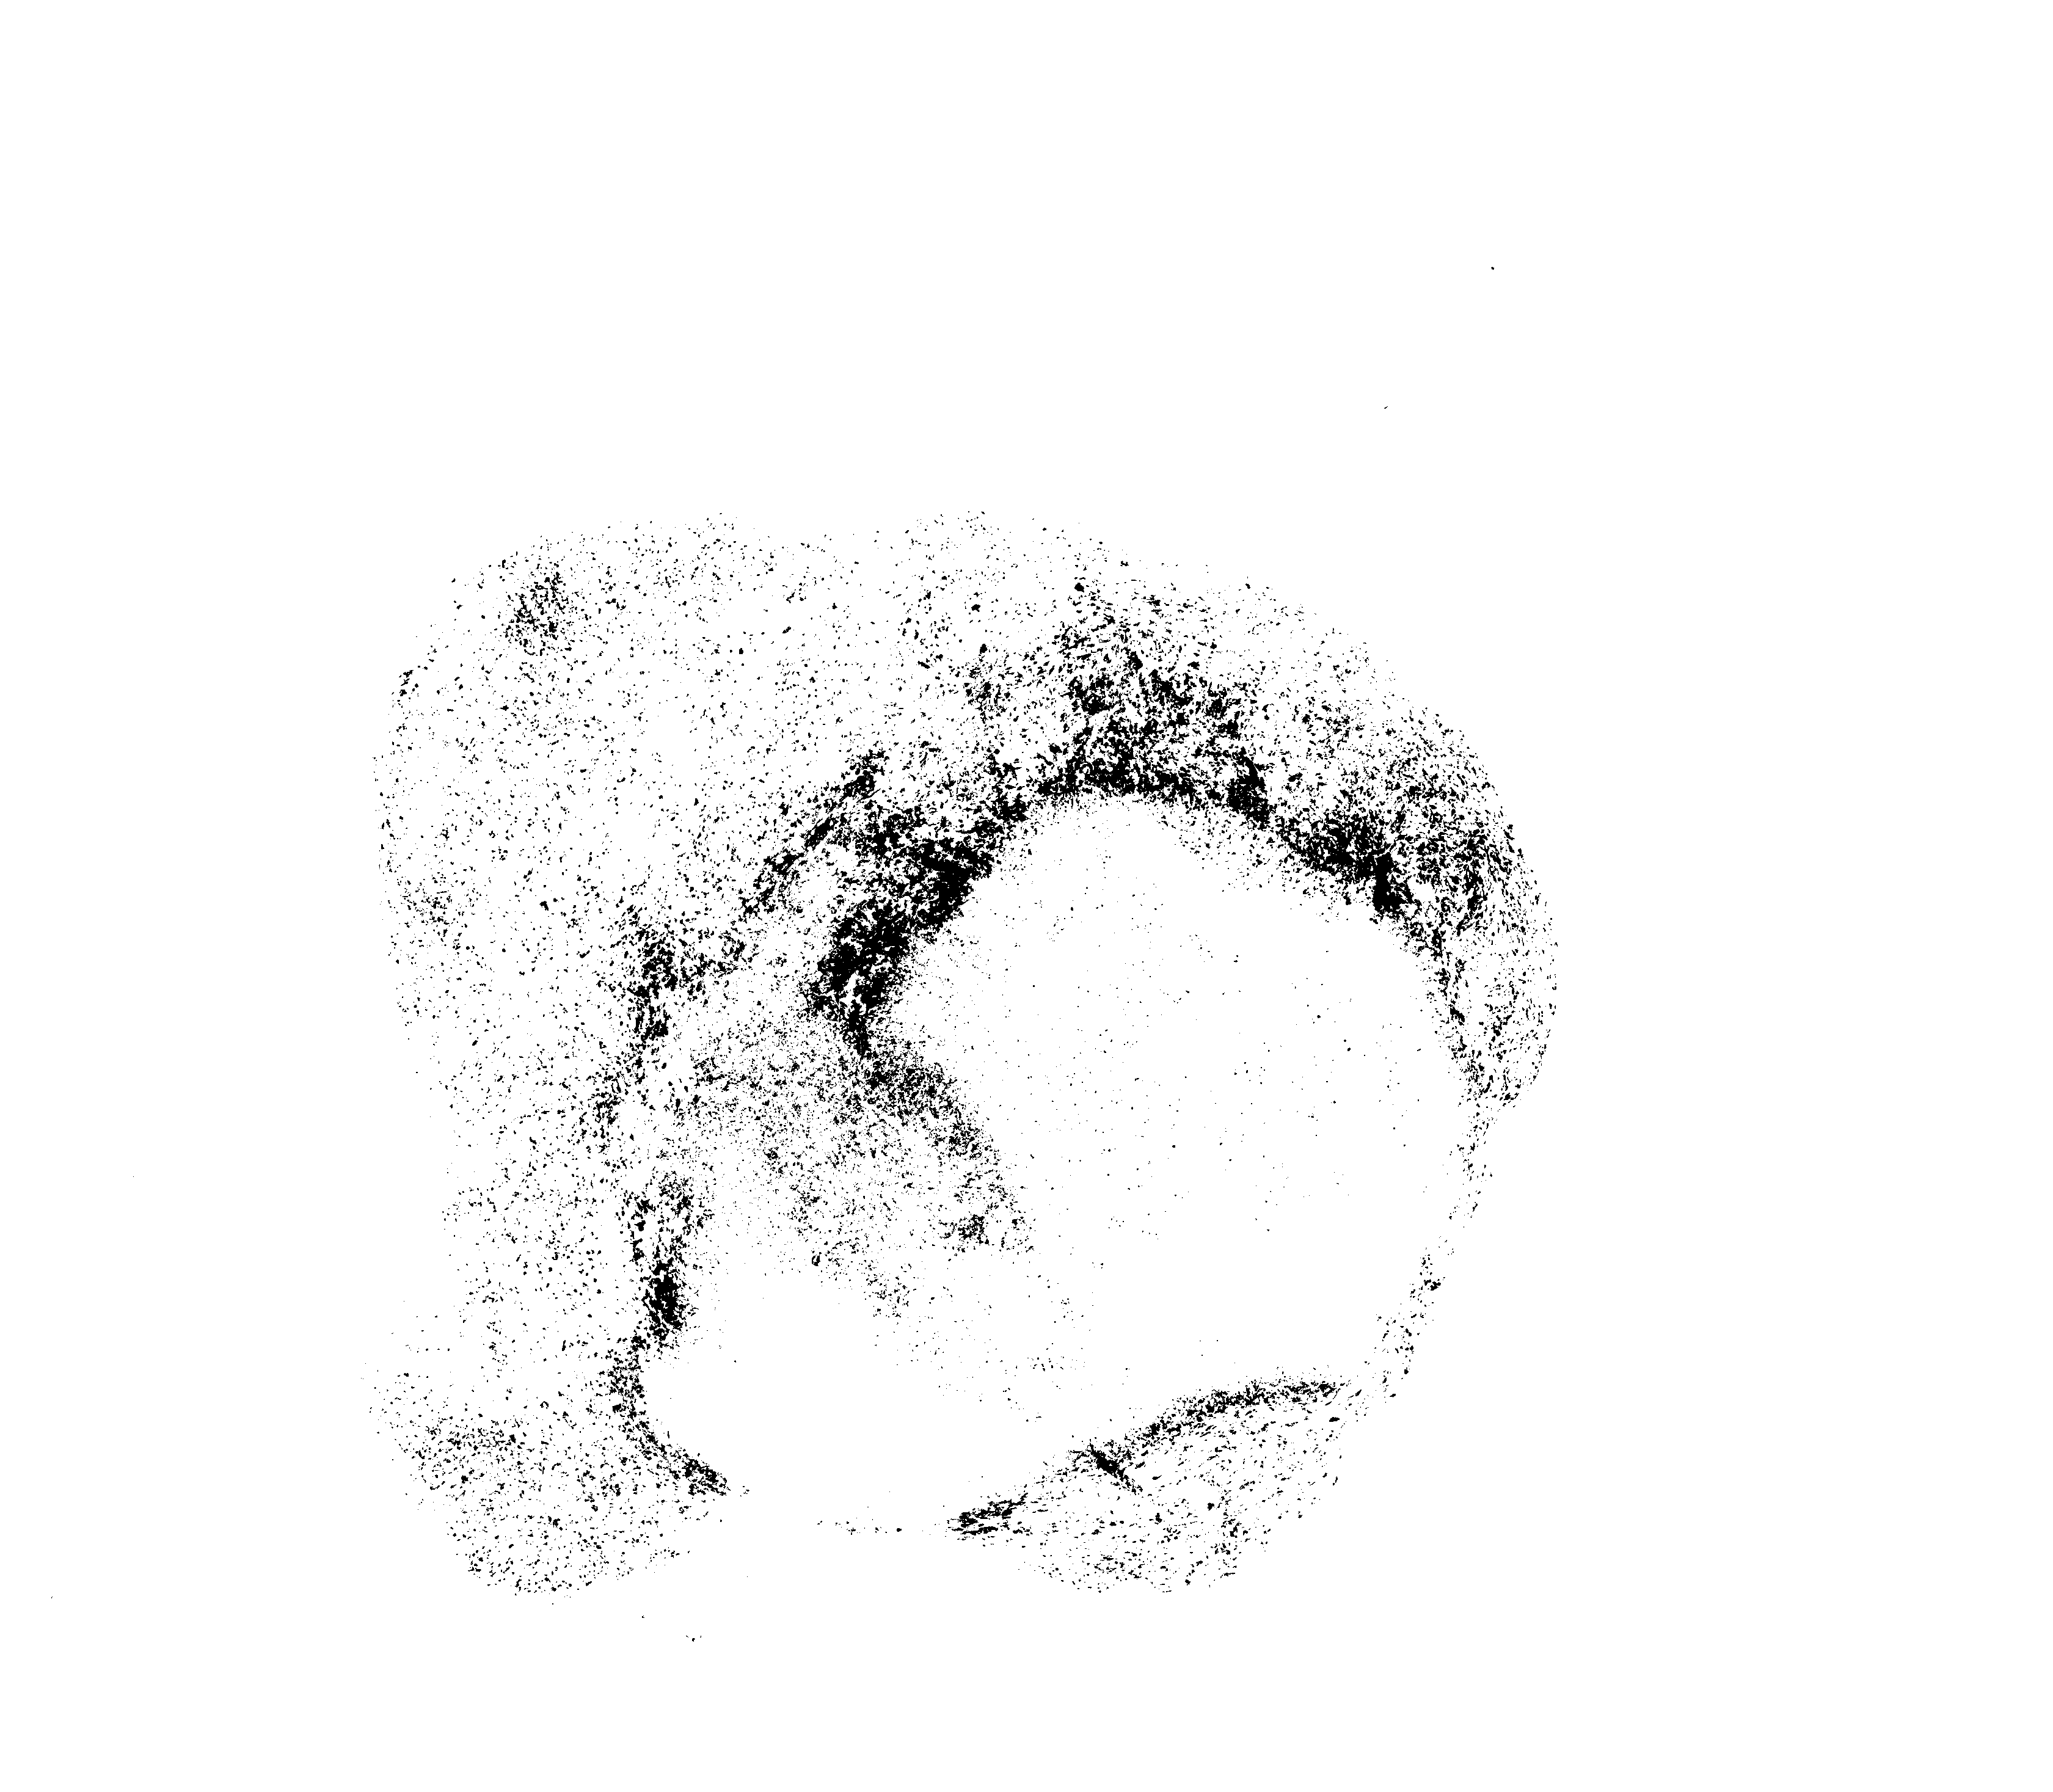
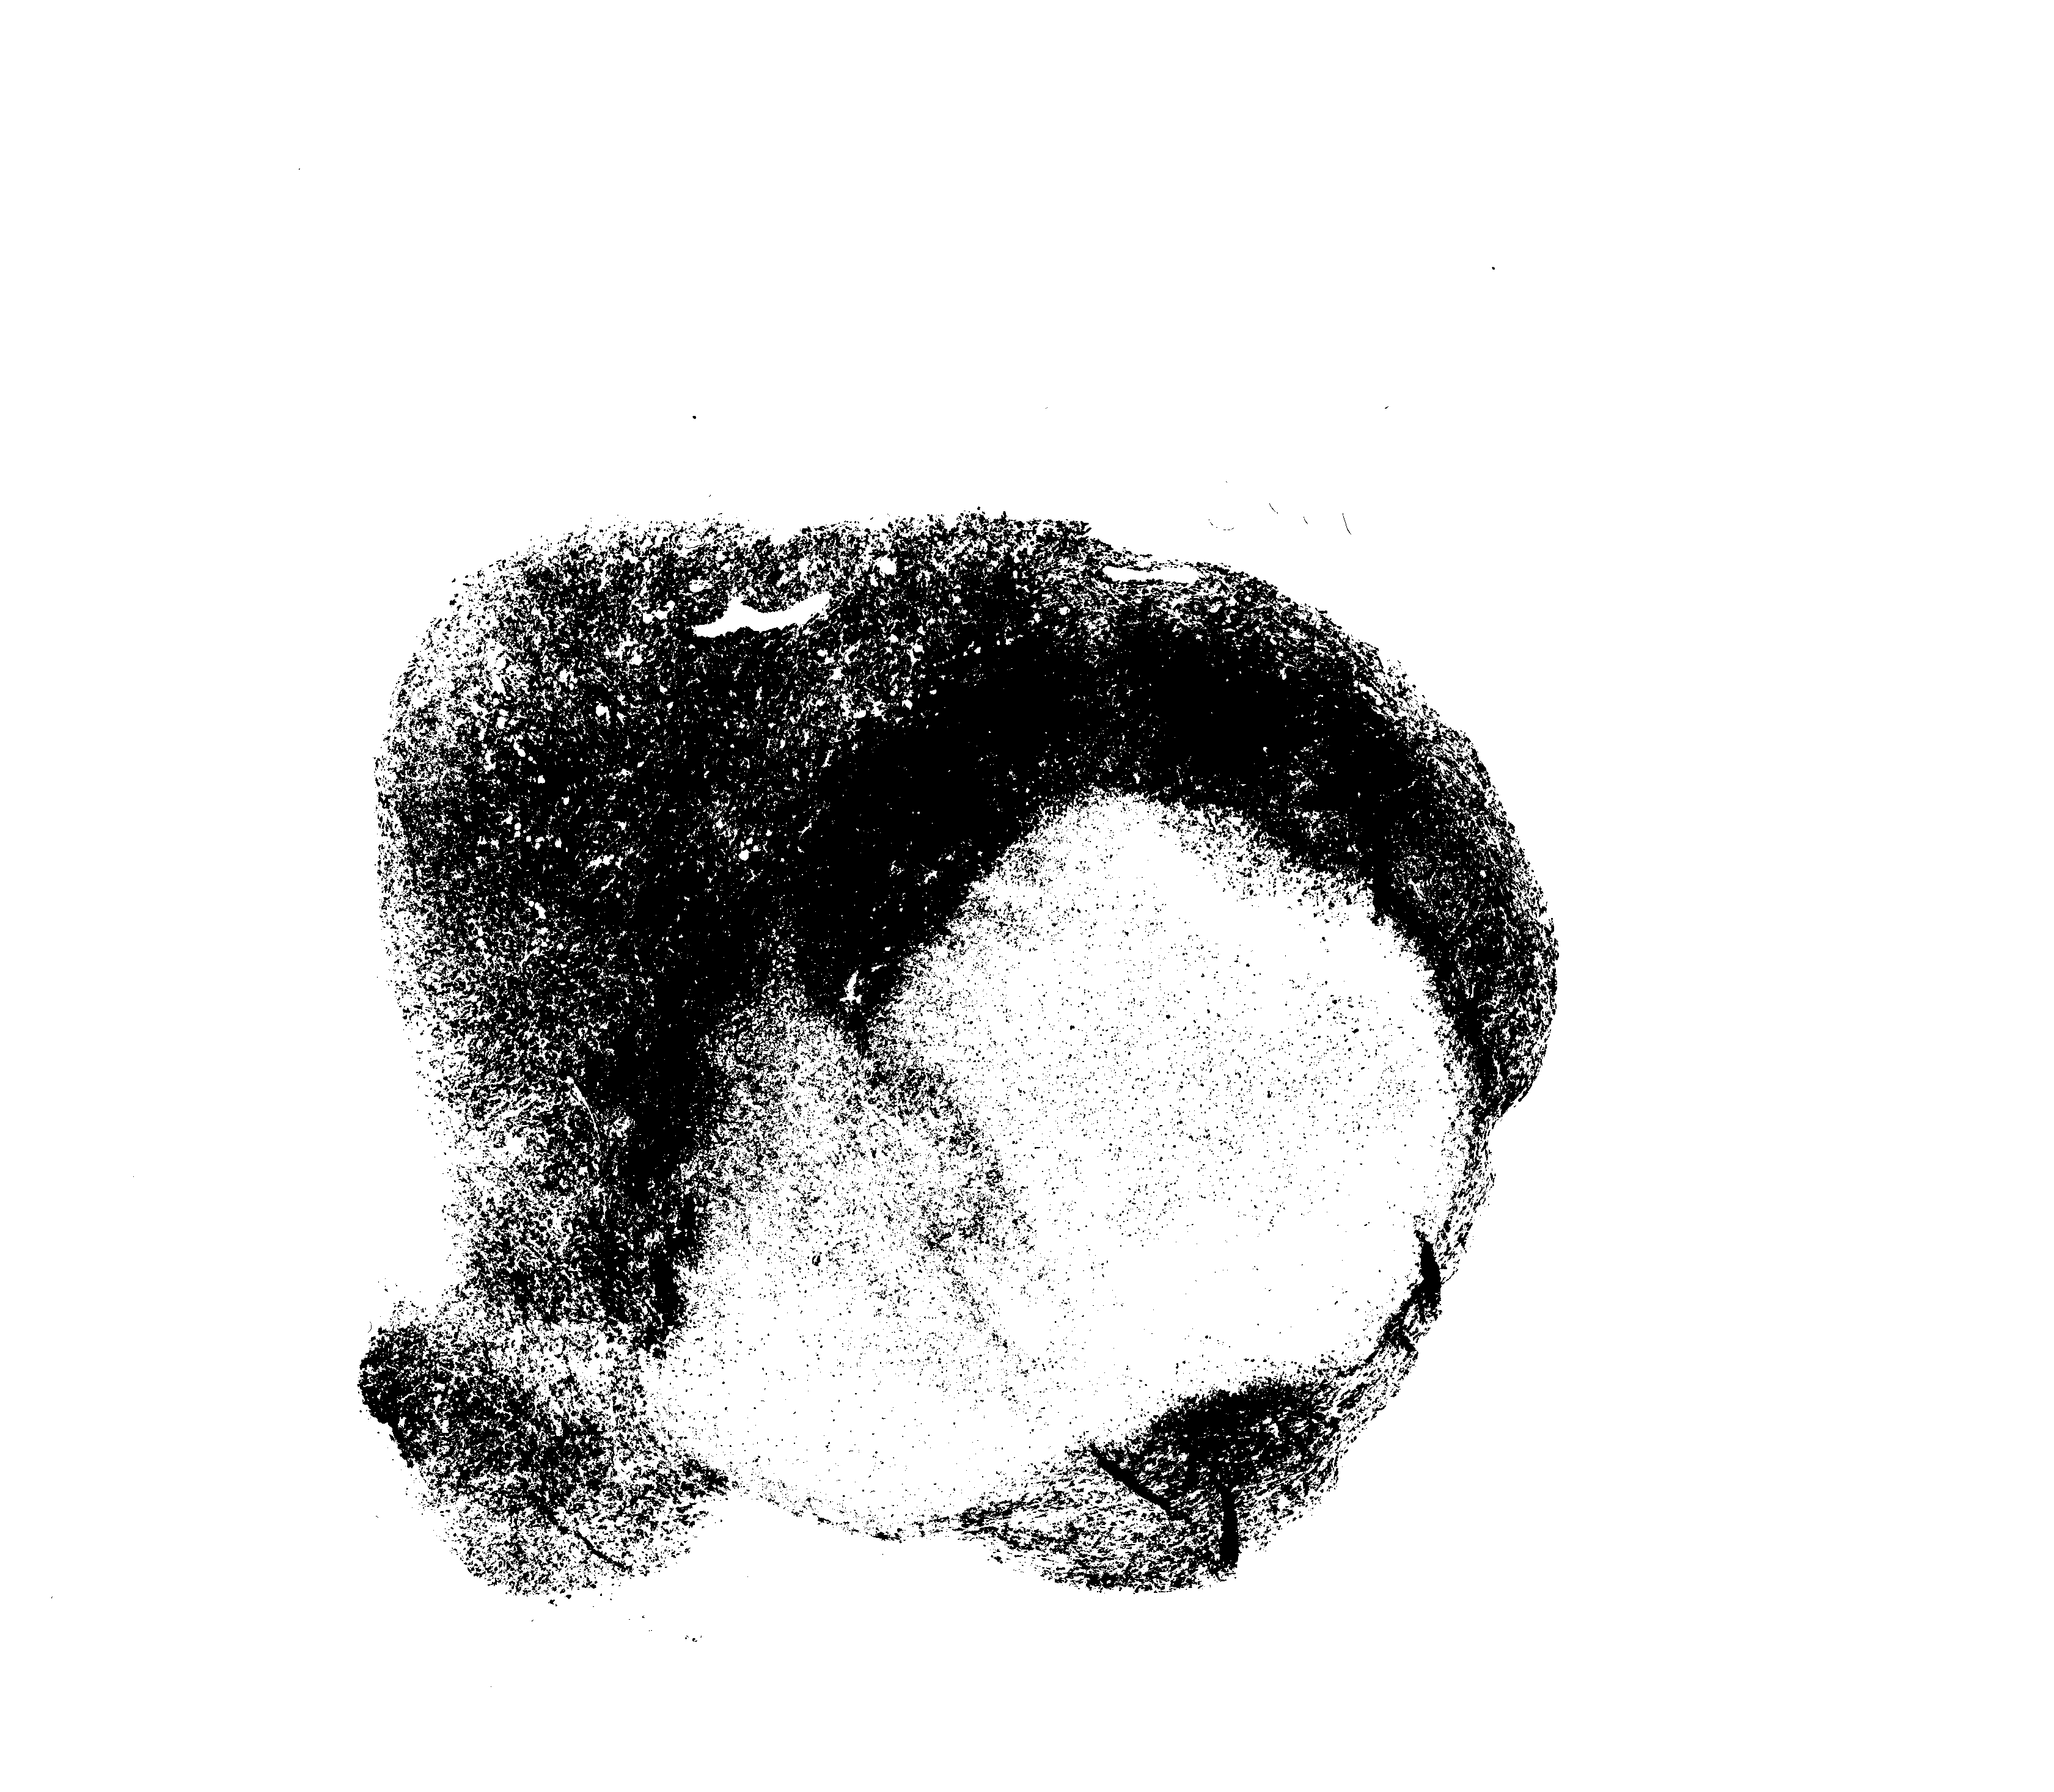
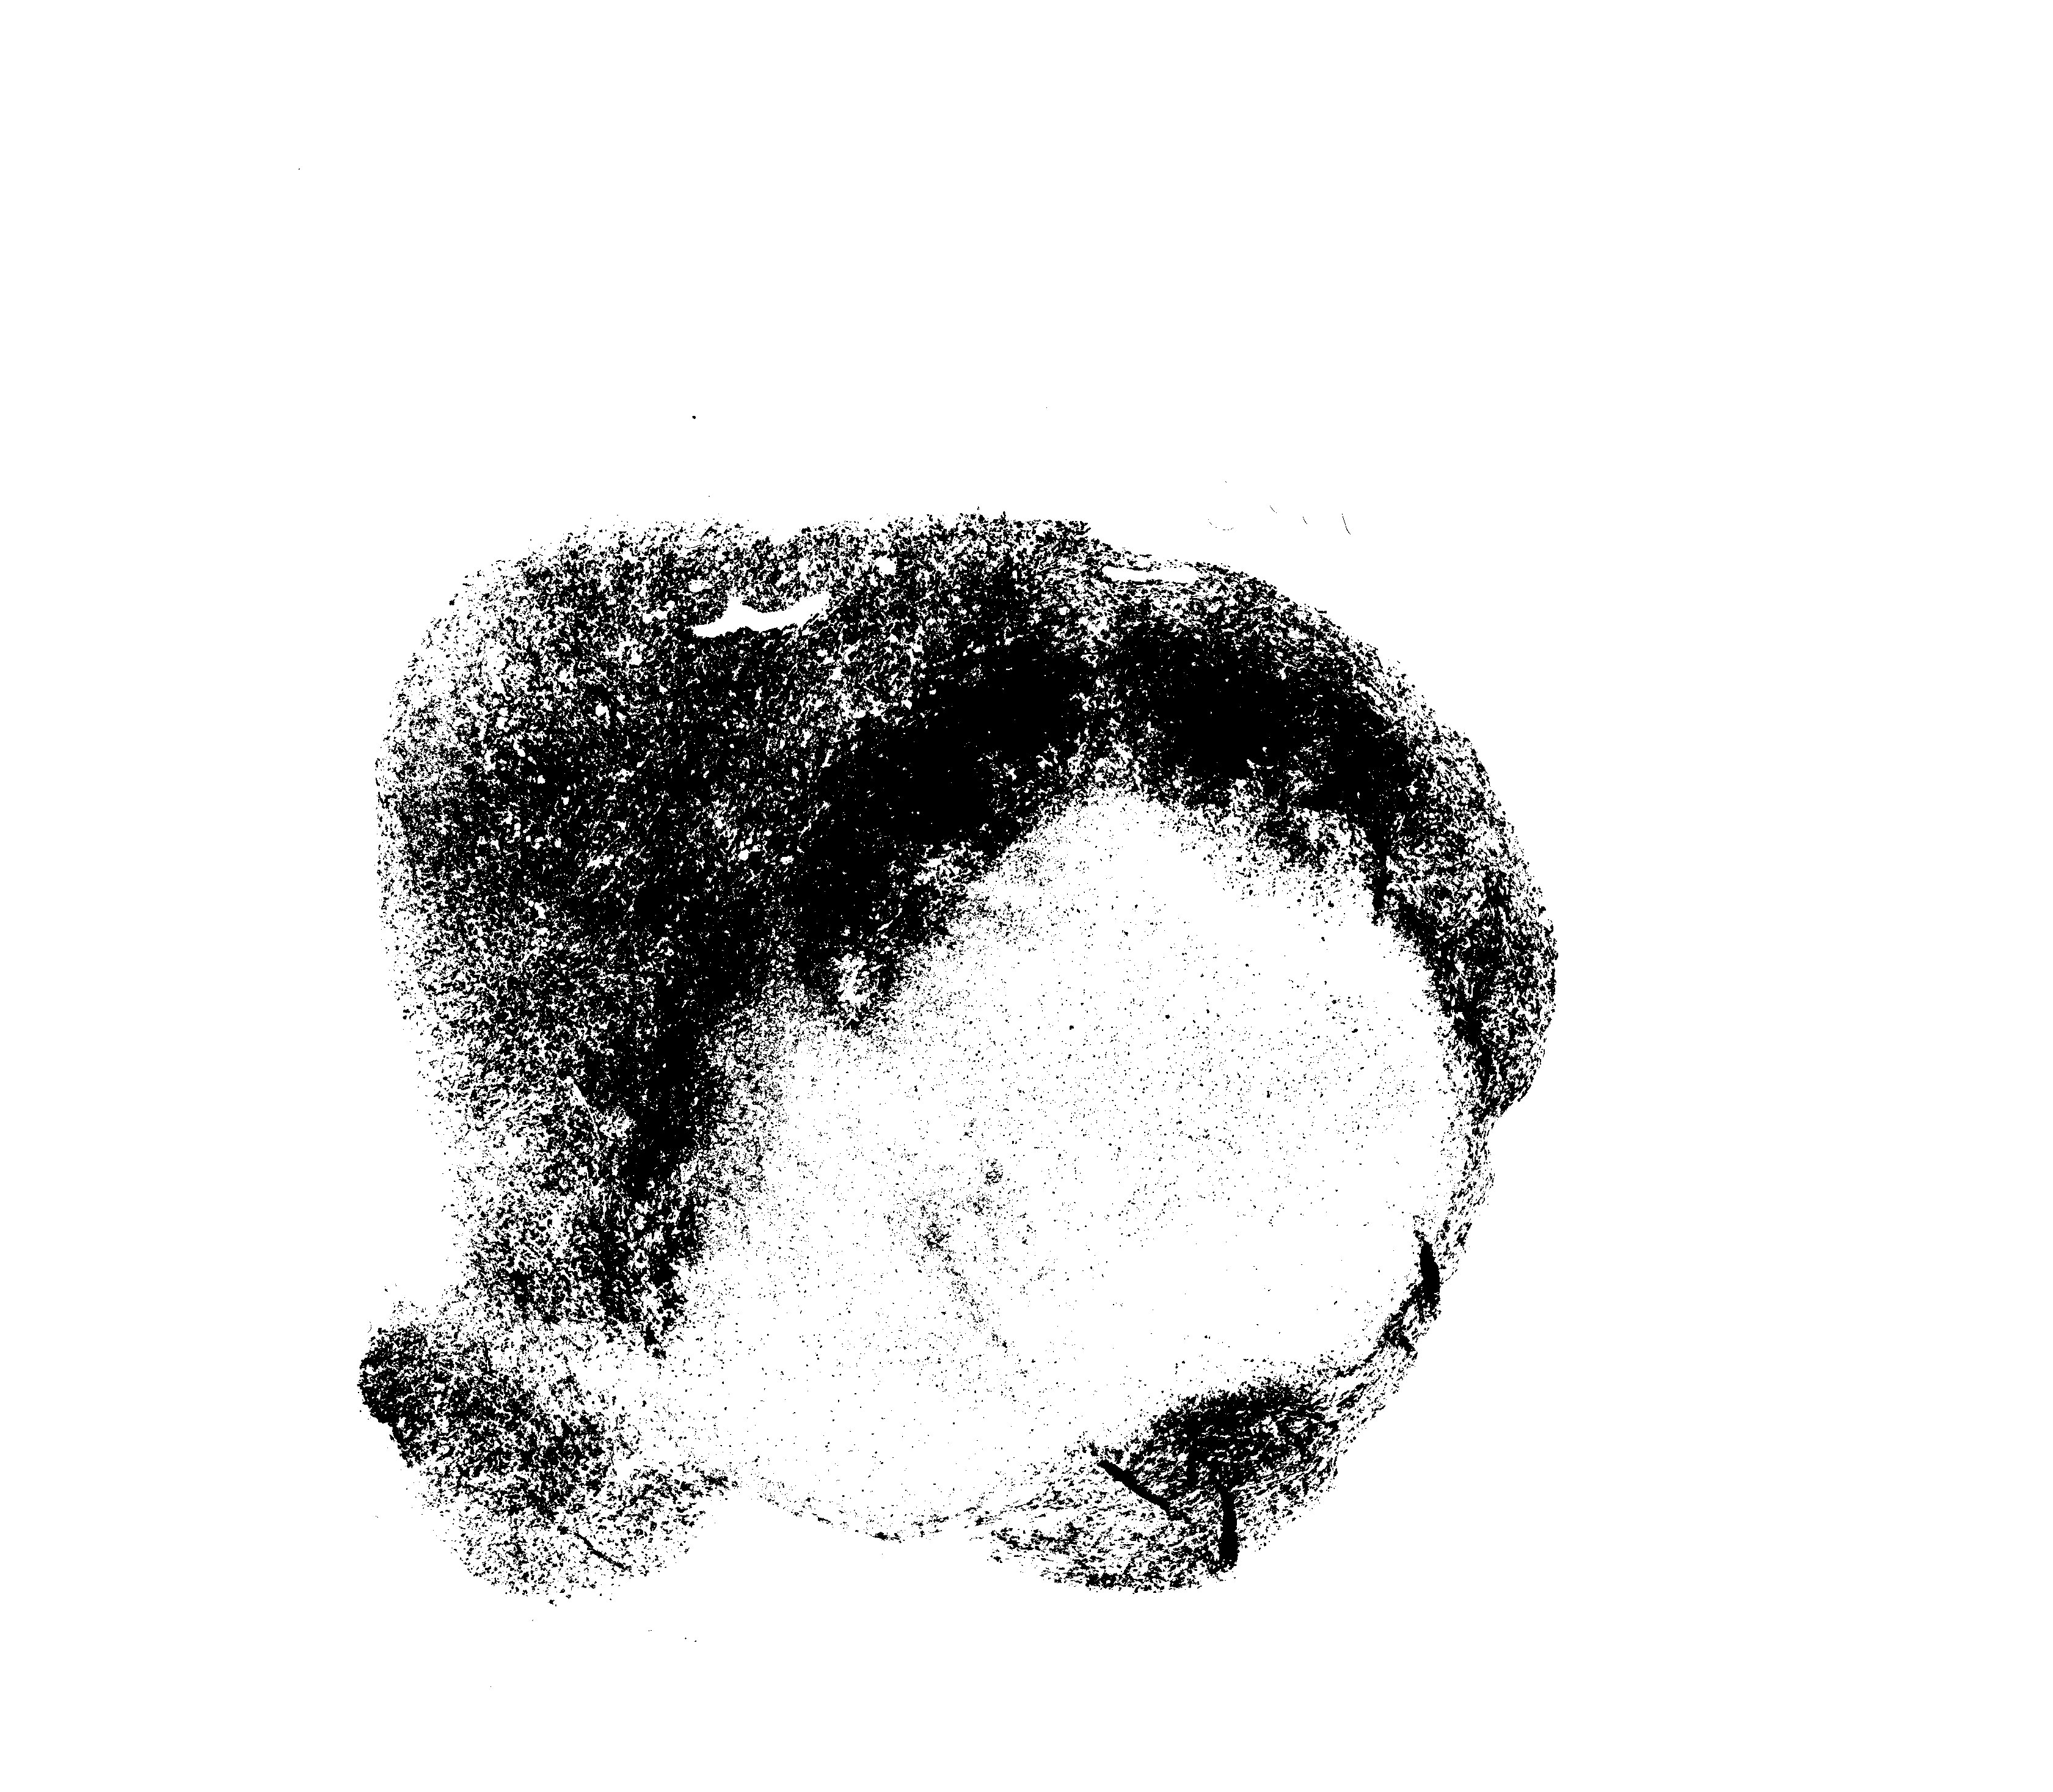
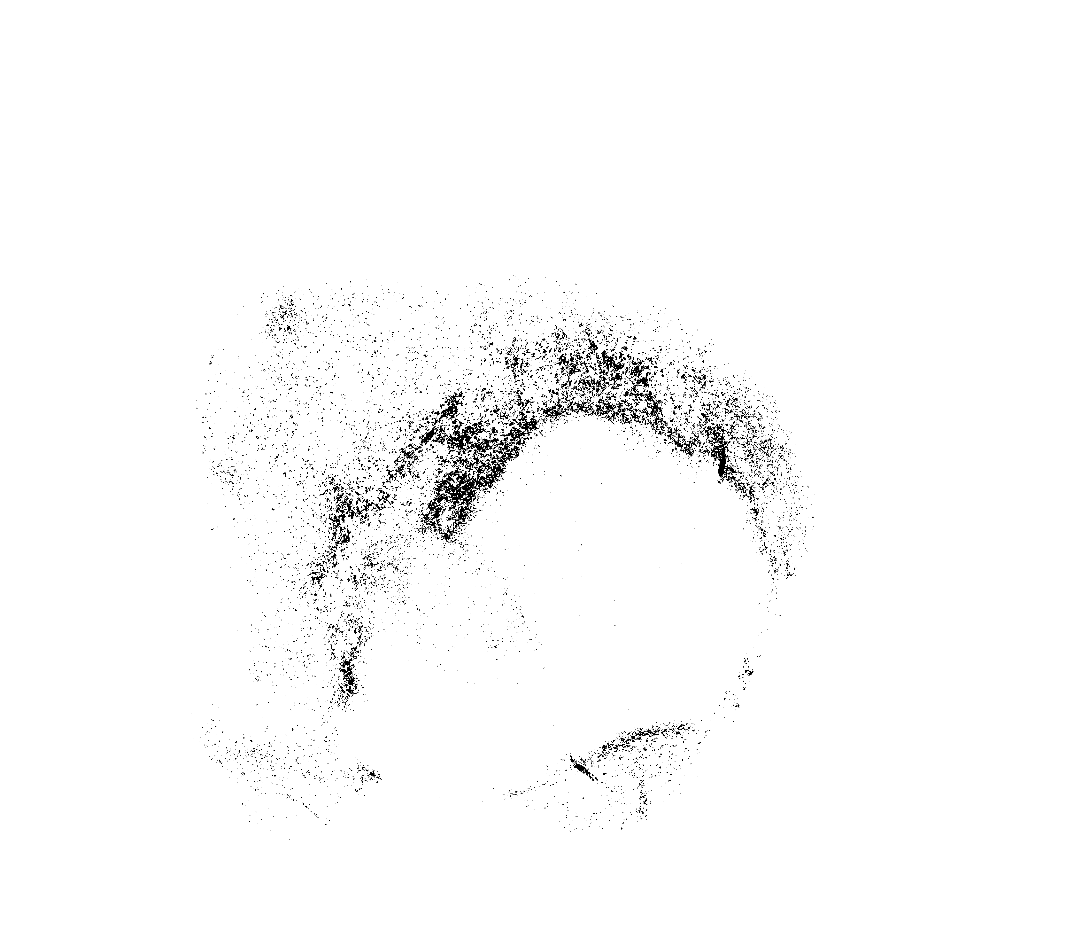
DAPI
1
2
3
Frame area
Tumor area
DAPI %area
GFP
4
6
5
-
=
Tumor
Necrotic
Viable
Necrotic area
GFP %area
8
DsRed
X
=
7
DsRed
GFP
Double
9
+
-
=
DsRed %area
DsRed
GFP
Double
Viable II

Slide 3
10
/
Density
=
DAPI area
Viable
11
/
Viable Areas Ratio
=
Viable
Viable II
12
13
X
=
DsRed area
/
=
DsRed_{viab}%
DsRed %area
Frame area
DsRed
Viable
14
/
(
+
)
=
DsRed_{ratio}%
-
DsRed_{viab}%
DsRed_{viab}%
GFP_{viab}%
Double_{viab}%

Slide 4
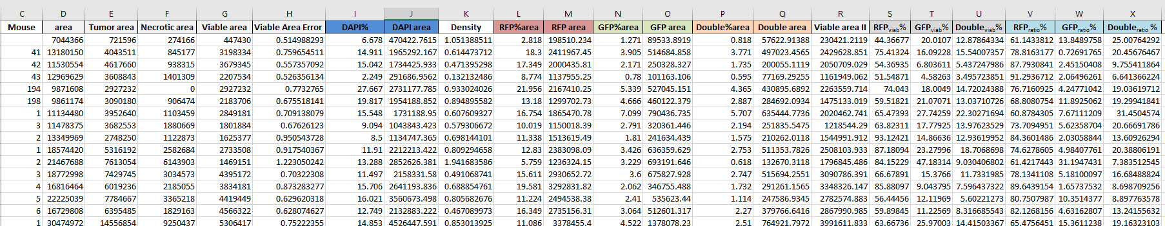
1
2
4
5
10
3
12
11
7
12
6
12
8
12
9
13
14

